Slide 2
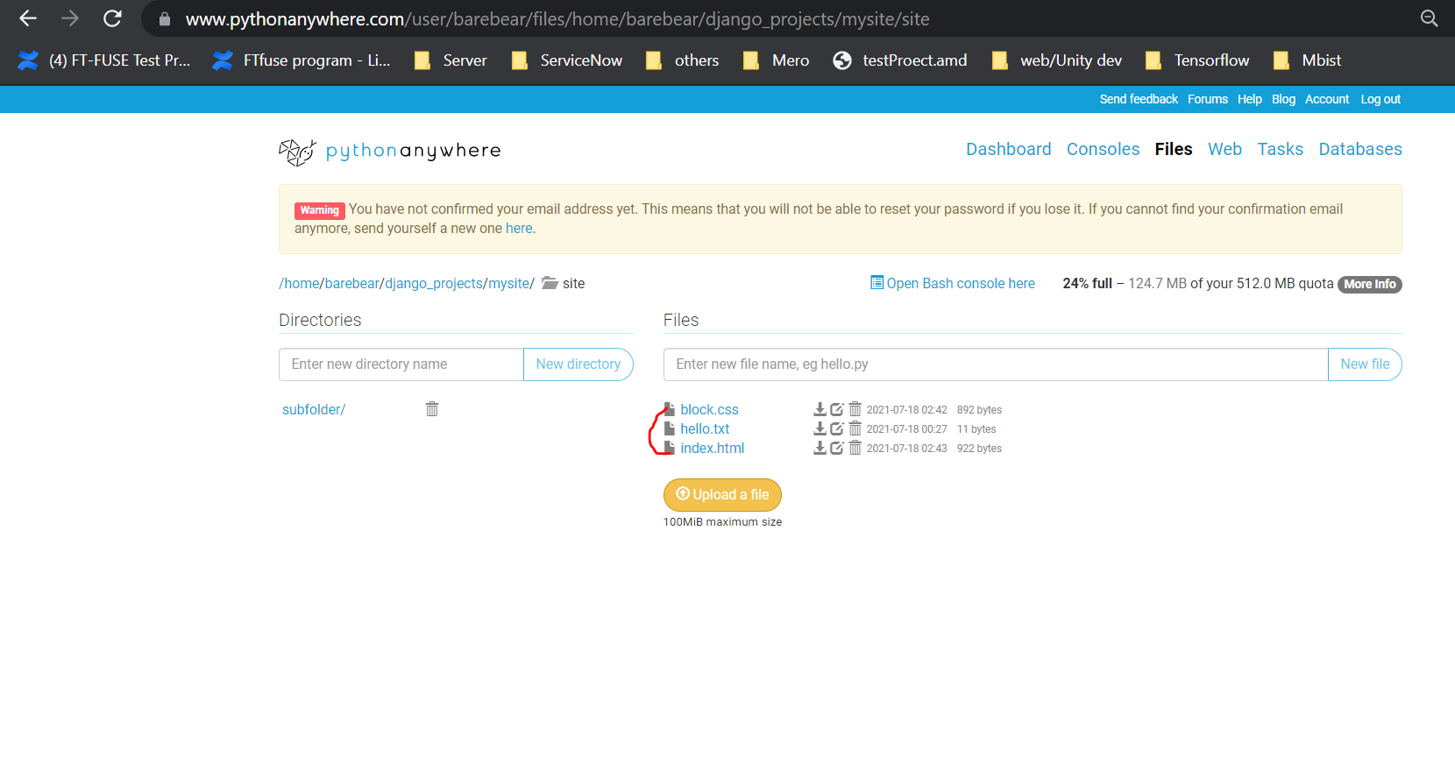
Create block.css and index.html
Create block.css and index.html under Django_projects/mysite/site

Slide 3
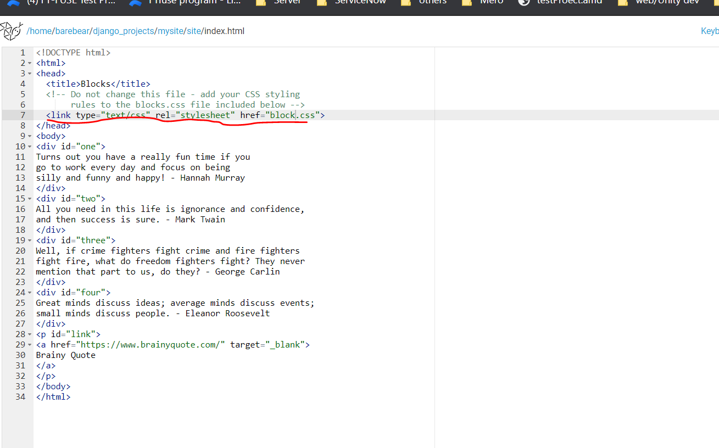
Index.html

Slide 4
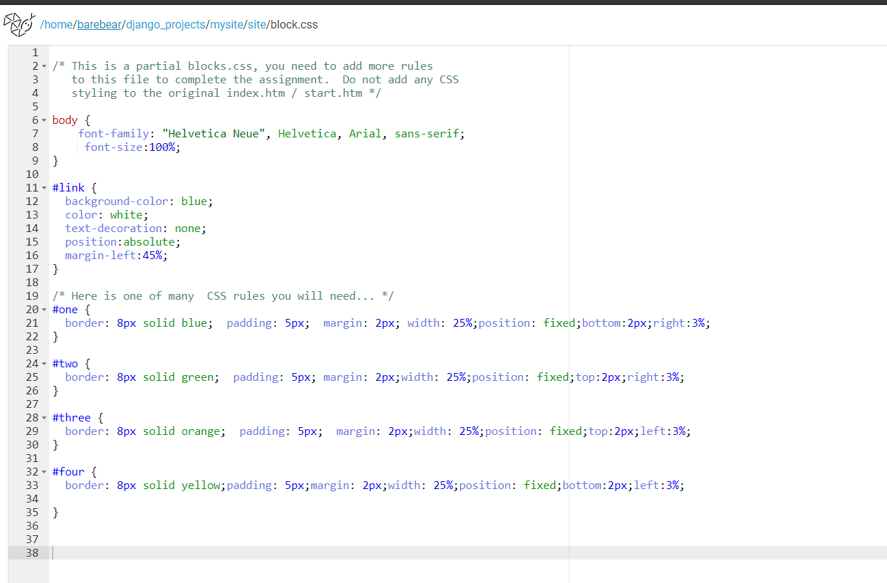
Block.css

Slide 5
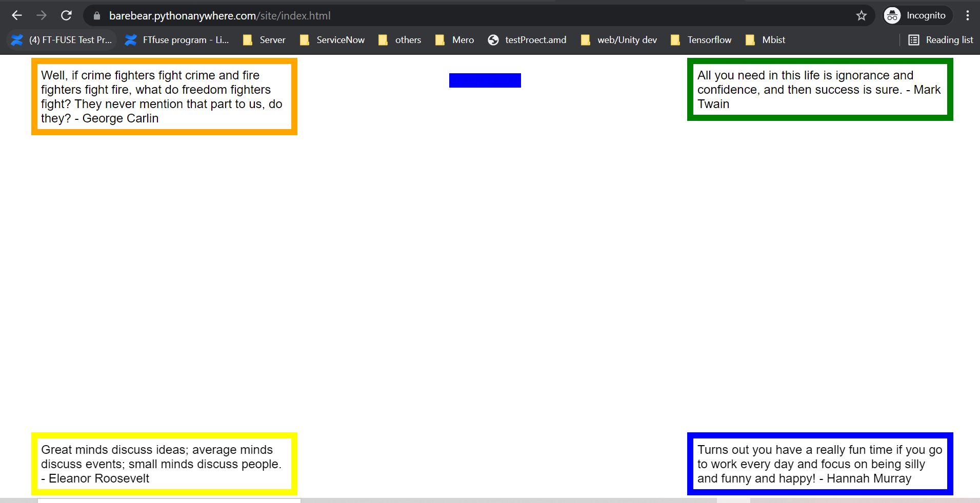
Final output

